Slide 1
WFTRun Data Object: for Wireline Formation Tester Data
For PRODML Version 2.0

Slide 2
Overview
This presentation deck includes slides for the WFTRun data object . For more information, see the PRODML Technical Usage Guide, which is included in the zip file when you download PRODML from the Energistics website.

Slide 3
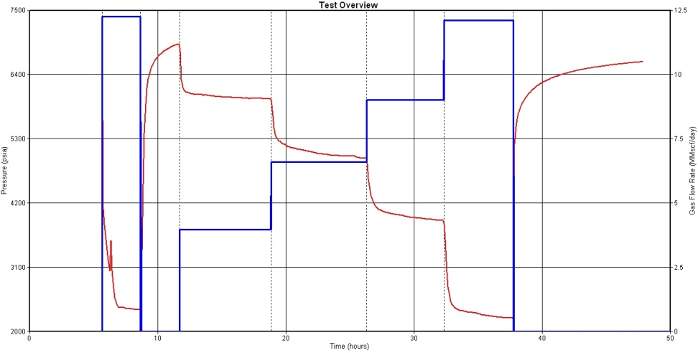
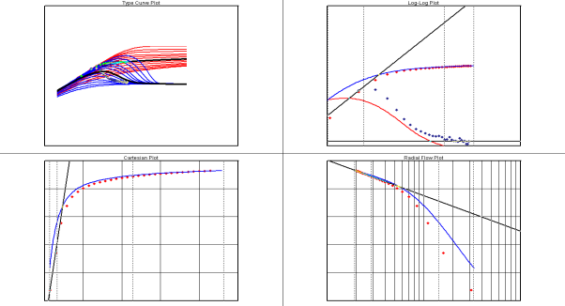
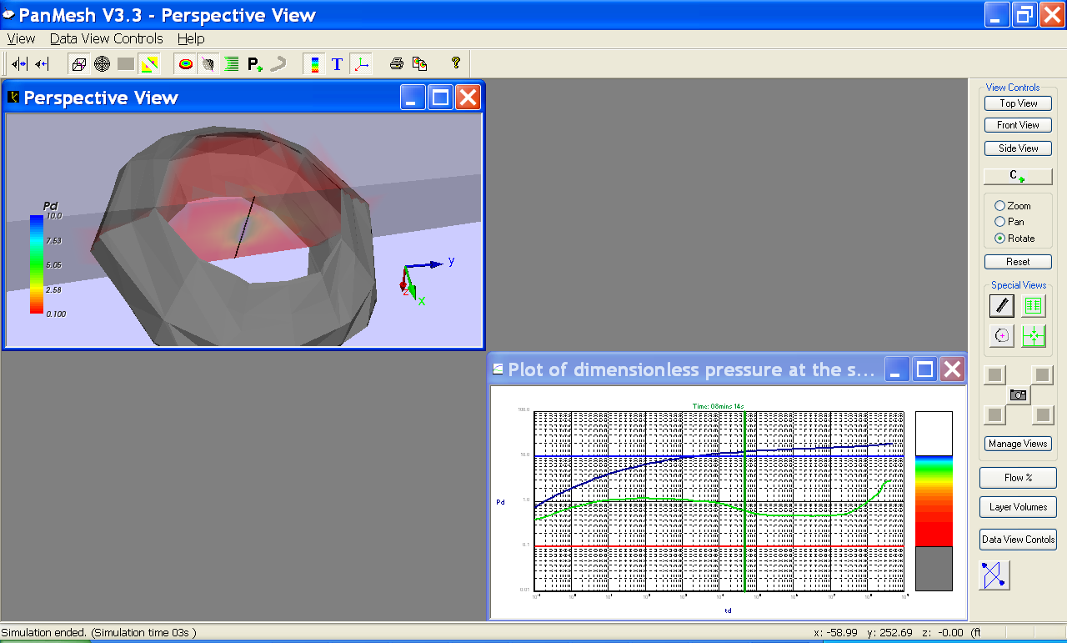

Scope of WFT Data within Reservoir and Production Analysis
Analysis
Time-series
Data
Flow
PVT Lab
Analysis
Transient
Welltest or
Wireline FT
Performance
& Res Descr.
Reservoir
Inflow
Parameters
Sample
P
Pressure
Transient
Fluids
Properties
P Gauge
Q

Slide 4
DST/WFT Workflow
Measured Data
Time series at specified flowing intervals/locations
Data pre-processing
Smooth/reduce, identify/tag test periods/kinds
Analysis
Output is reservoir/fluid parameters for the intervals
Samples may be associated with intervals
Lab reporting
Predict Performance
Use well models to predict what this well will behave like
Plus, results feed into reservoir description & dev. plans
Logs to help design and analysis

Slide 5
Note about the term “Welltest”
Welltest has two meanings commonly used:
A “production welltest” in which a producing well is diverted to a test separator so its steady-state rate can be measured. Used for monitoring and for input to allocation.
Prodml wellTest data schema
A “transient welltest” in which a well (often appraisal in addition to producers) is flowed and shut in to analyse the transient response. Used for obtaining reservoir parameters.

Slide 6
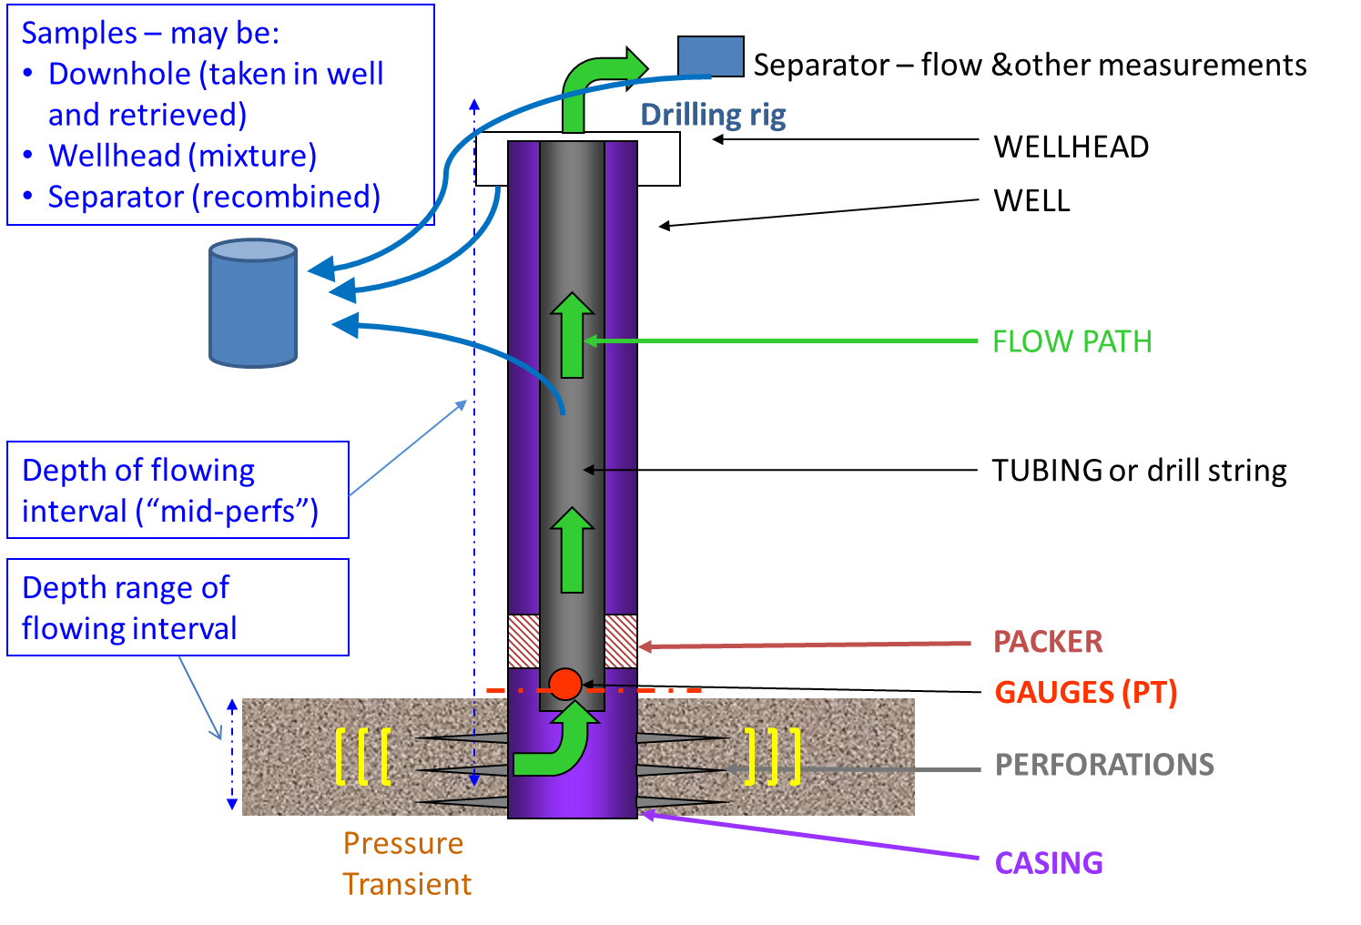
Physical set up (typical Drill Stem Test)

Slide 7
Notes on Drill Stem Test
P, T measured in gauge near - but not coincident with - tested interval
Test may straddle multiple flowing intervals (so response is aggregate of intervals)
Flow of oil, water, gas and fluid measurements usually made on surface at separator
May be multiple DSTs per well at different intervals (performed in sequence one by one)
Samples may be captured in well and brought to surface, taken at wellhead or taken post-separator and subsequently recombined.

Slide 8
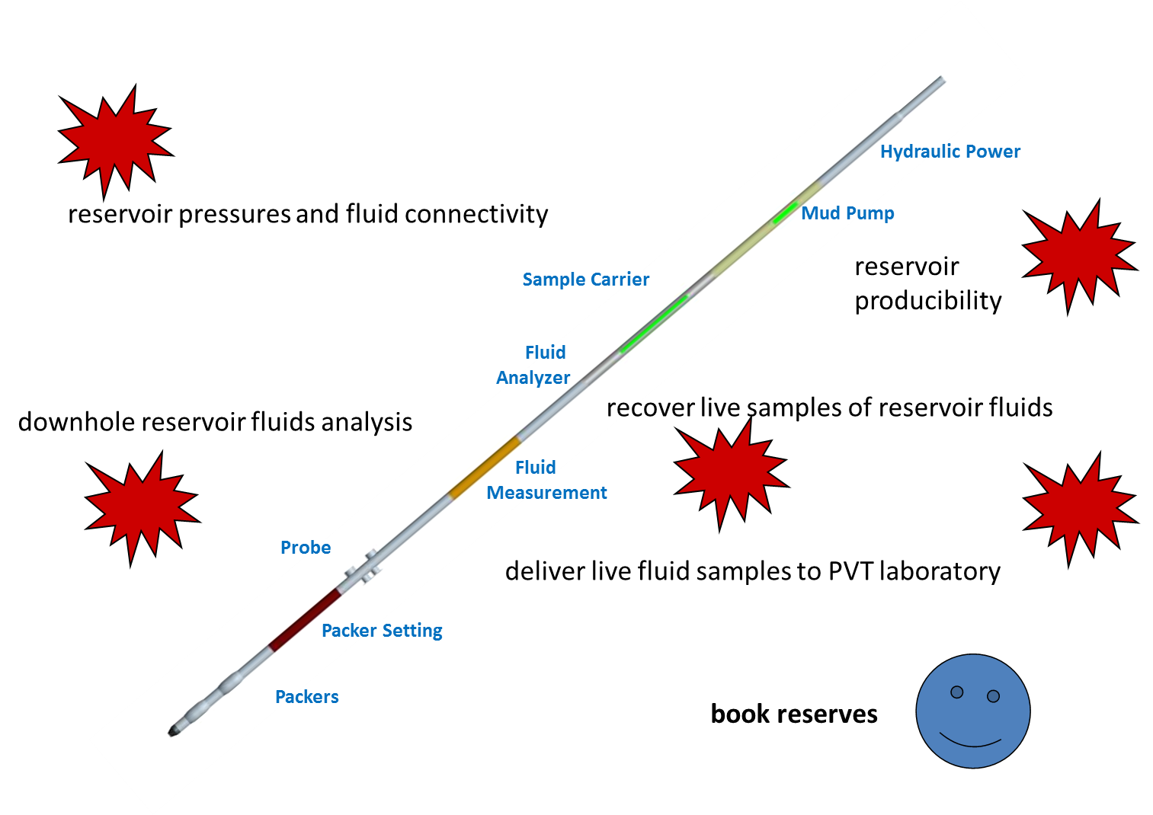
Wireline formation tester (typical)

Slide 9
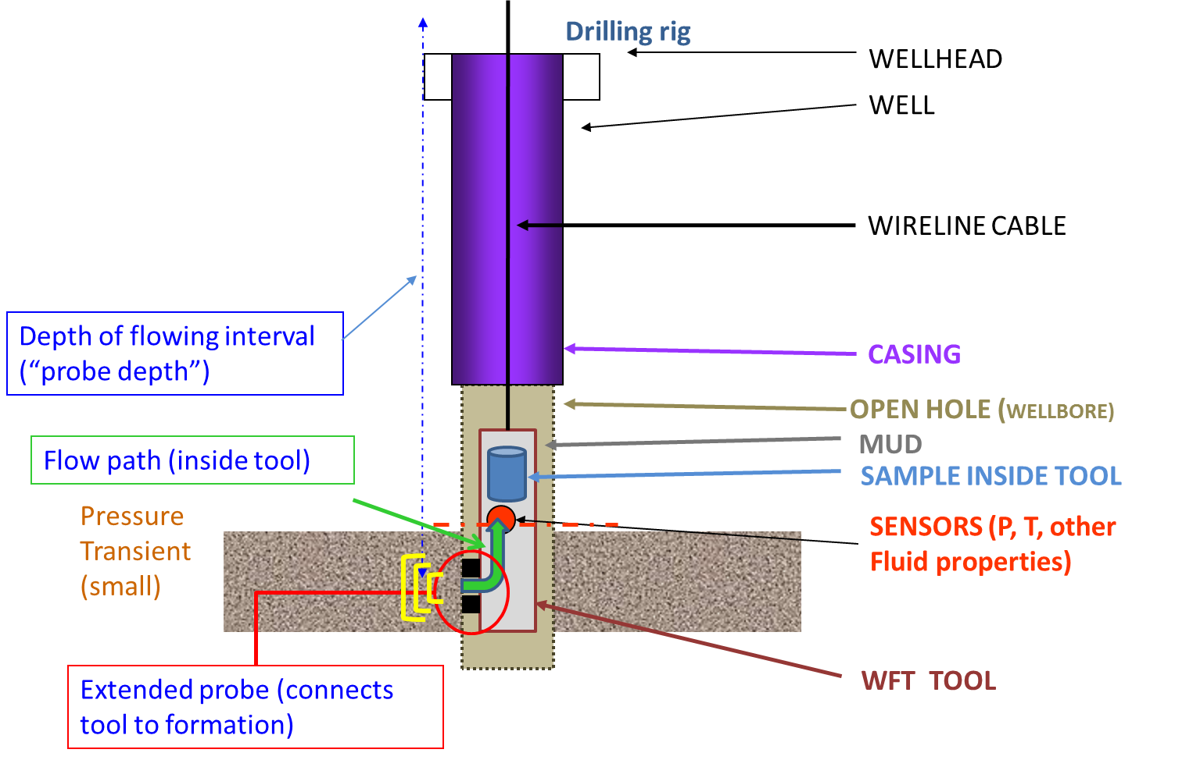
Physical set up (Wireline Formation Tester WFT)

Slide 10
Notes on WFT
Tool lowered on wireline – NOT a continuous log but stops and sets probe at selected points
The flow is at a probe not a radial flowing interval
When probe set we can flow formation fluid into tool:
Makes time series measurements of fluid properties as the flow into tool continues
Can take sample(s) and bring to surface
Sometimes called a “mini-DST”

Slide 11
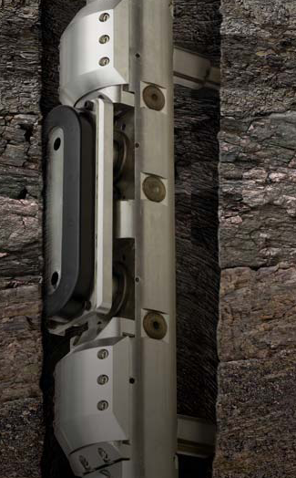
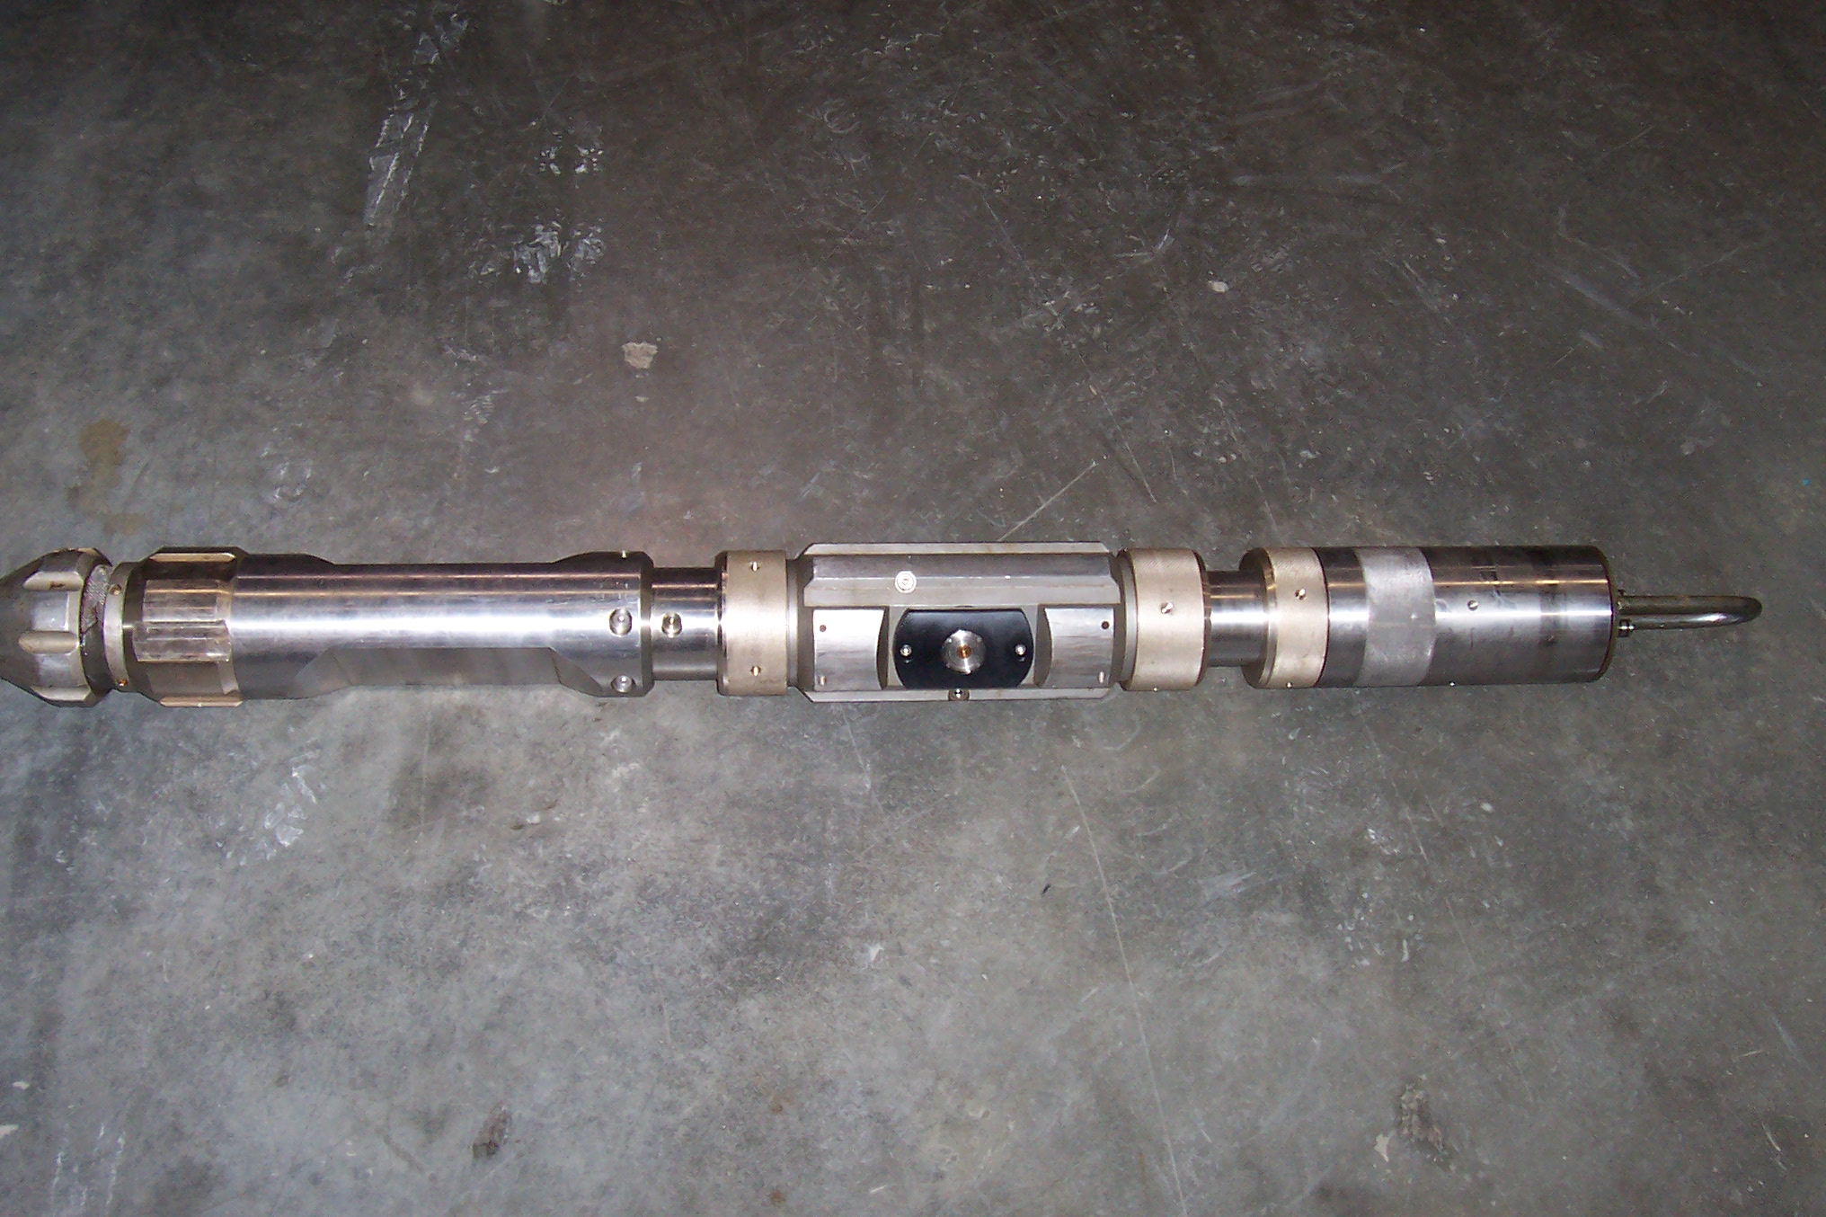
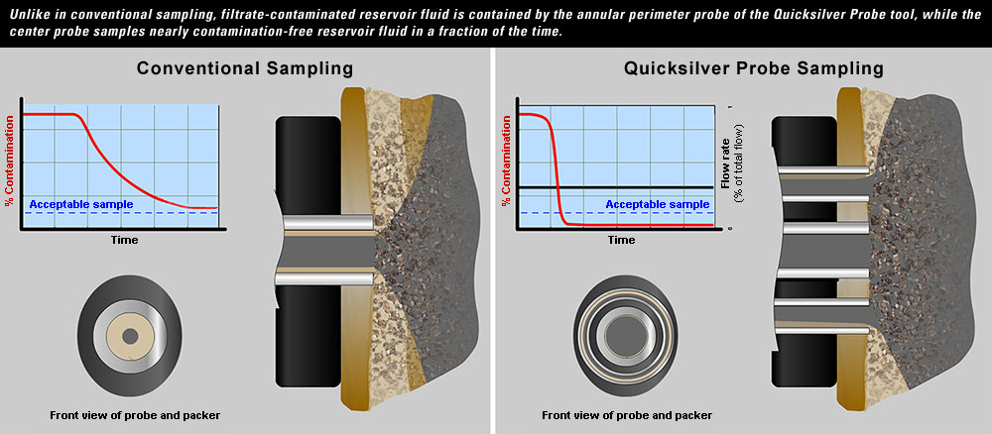
WFT Probe Types (examples)
Oval Pad Probe
Single Probe (Weatherford photo)
Central plus annular Probe
See:~http://www.halliburton.com/public/common/Data_Sheets/H06089.pdf
See:~http://www.slb.com/content/services/evaluation/reservoir/quicksilver_probe.asp?

Slide 12
Variations with WFTs
1. WFT using packers not probe
Flow path radially symmetrical like DST
SAMPLE INSIDE TOOL
SENSORS (P, T, other
Fluid properties)
Pressure
Transient
WFT TOOL WITH PACKERS
2. WFT using observation probe
OBSERVATION PROBE
(P, T)
SENSORS (P, T, other
Fluid properties)
Observation probe (measures interference pressure)
WFT TOOL WITH PACKERS AND PROBE

Slide 13
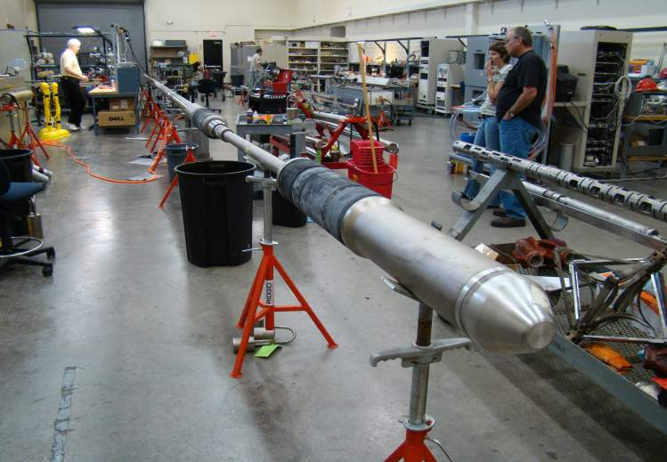
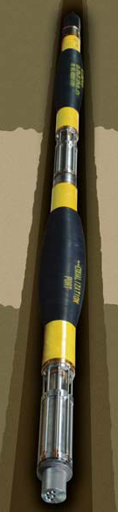
WFT Packers

Slide 14
Notes on Measured Data DST/WFT
Often there are 2 or more asynchronous streams of data from different measurement points, but relating to one test interval, e.g.:
pressure at bottom of well, flow at surface
WFTs can flow a test interval or a point probe
Interference test where the data relates to two flowing intervals and the interference between them, e.g.:
WFT interference test to observation probe (previous)
Well to well interference (flow one, observe in other)
Vertical interference (flow one interval in well, observe at another)

Slide 15
Notes on Pre-Analysis Data Prep.
Test periods are periods of ~ constant flow. “Rate changes” is time series of the “steps” separating test periods. ➔
Data qualifiers to tag data streams as measured smoothed, reduced etc
Need to associate right sets of time series with each other in “analysable dataset”.
Rate changes
(series points)
Test period
Pressure (high
frequency stream)
Flowrate stream
has been simplified
to these averages

Slide 16
Notes on Analysis
Any transient test analysis has a set of input parameters and result parameters
Time series data (as above) is always an input
The exact set of input and result parameters depends on the analysis model:
Example models: Well near a fault; fractured well etc
Example parameters: reservoir av. pressure, permeability, porosity. (All at specific location/region).
Other results have corresponding analyses (incl. average values and similar, less algorithmic)
Some analysis results are inputs to other analyses
Eg, calculate viscosity which is input to permeability

Slide 17
Notes on Analysis (cont.)
Well logs are needed:
Wireline
LWD
Mud Logs
Well Survey also needed
Need to track depths relative to datum acress wells
WFTs produce their own depth-based well logs for depth correlation

Slide 18
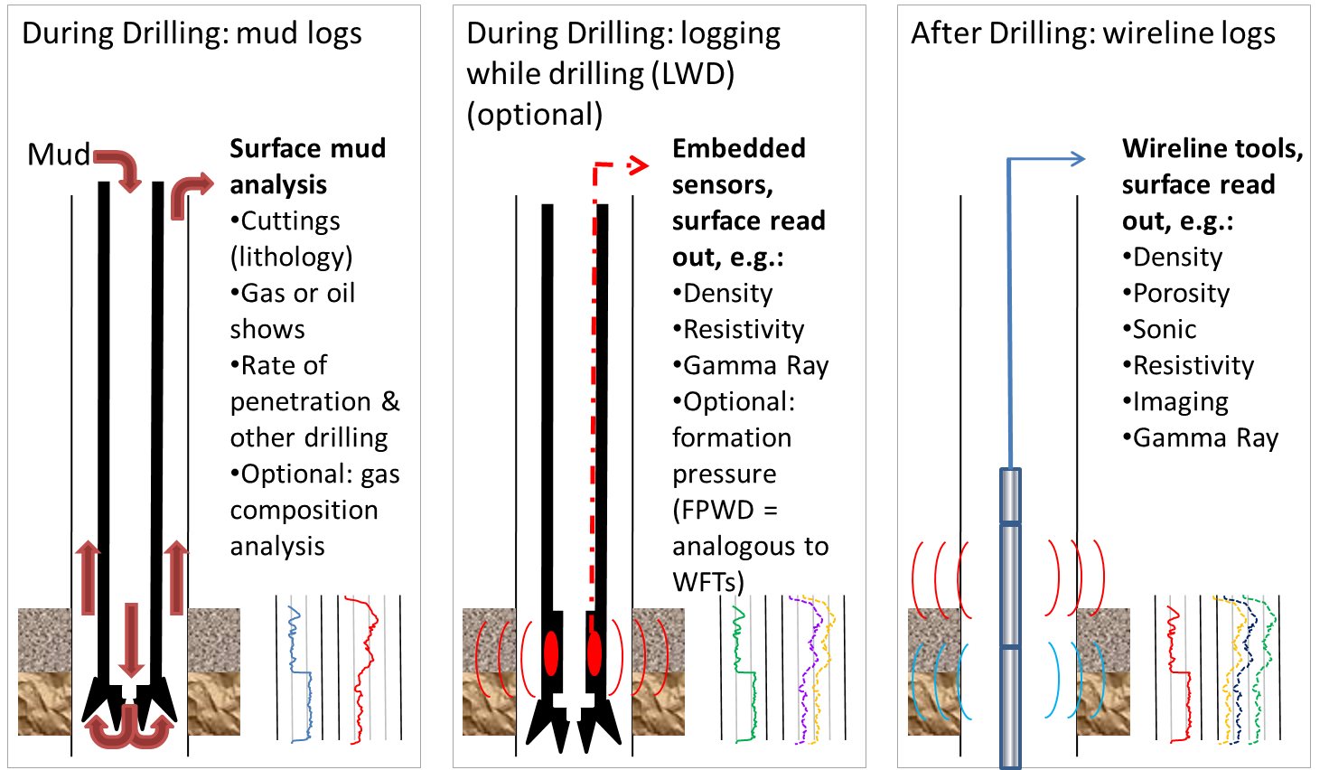
Wellbore Data Available during and after drilling, for use in Test Design and Analysis

Slide 19
Notes on Samples
Samples of fluids are associated with specific flowing interval(s) and time at which sampled.
Samples may have tests made at wellsite (e.g., water cut, as reported in current wellTest)
Or – samples may go to lab for detailed PVT analysis
Need to track samples & report lab results

Slide 20
Notes on Performance Prediction
Once Analysis is complete, can move on to predict performance of this well.
Welltest results (which may be layer by layer) feed into well models:
Analysis results (such as permeabilities, other reservoir and fluid properties from the test)
Samples results (fluid properties from lab tests)
➔ Reservoir Inflow Performance (into well)
At this stage, workflow “hands off” to Production
Well trajectory for wellbore path
Well completion for lift performance of well from flowing interval(s) to surface = “Nodal Analysis”

Slide 21
Notes on Reservoir Description
Properties derived from transient analysis and fluid properties feed into reservoir models
Upscaling
Fluid Properties also used to determine facilities capacities needed (eg, GOR, H₂S, etc)

Slide 22
WFTs: Multiple Layers Tested
Can test, sample, analyse and report flowing interval by flowing interval.
Each “stop” is referred to as a Station.

Slide 23
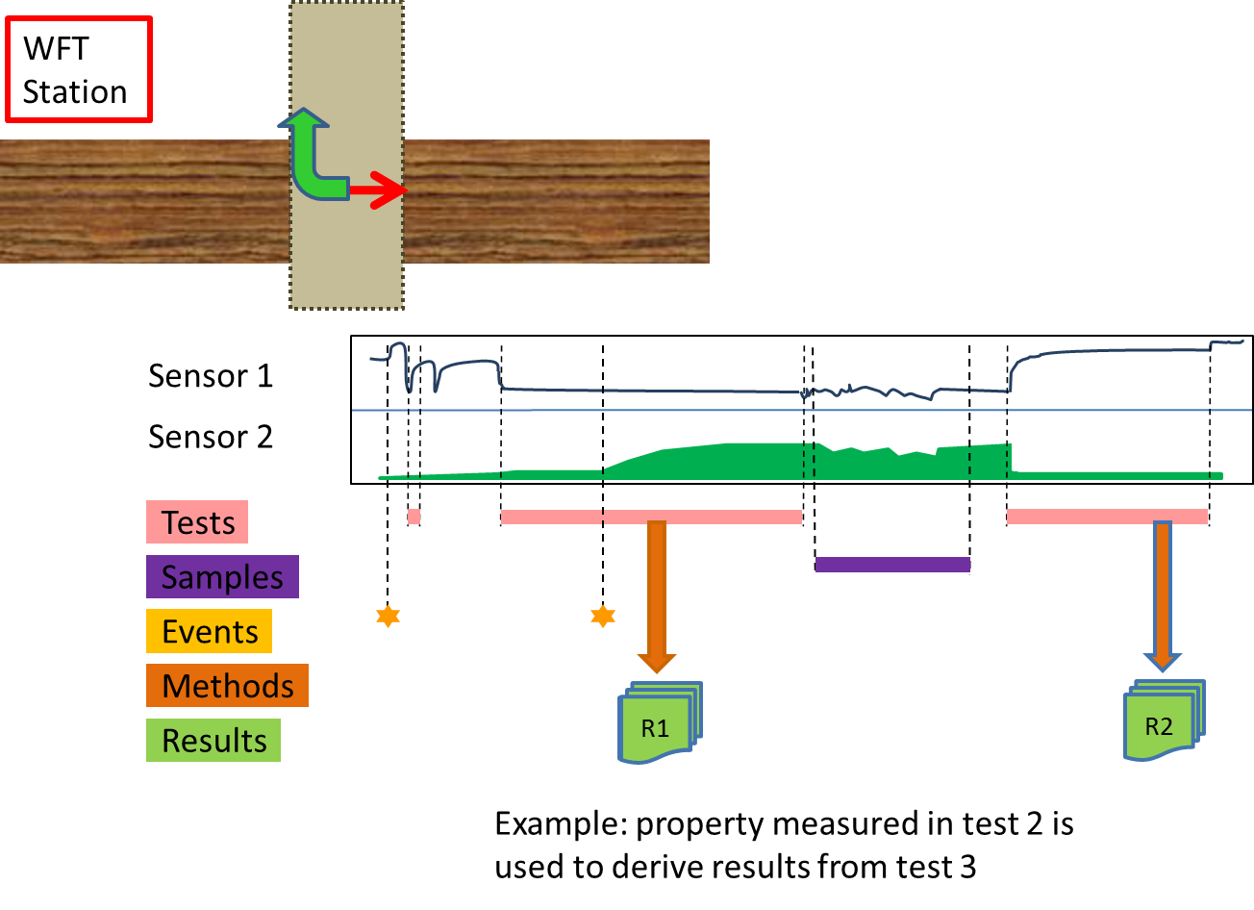
Results Derived From Results
Example: property measured in test 2 is used to derive results from test 3

Slide 24
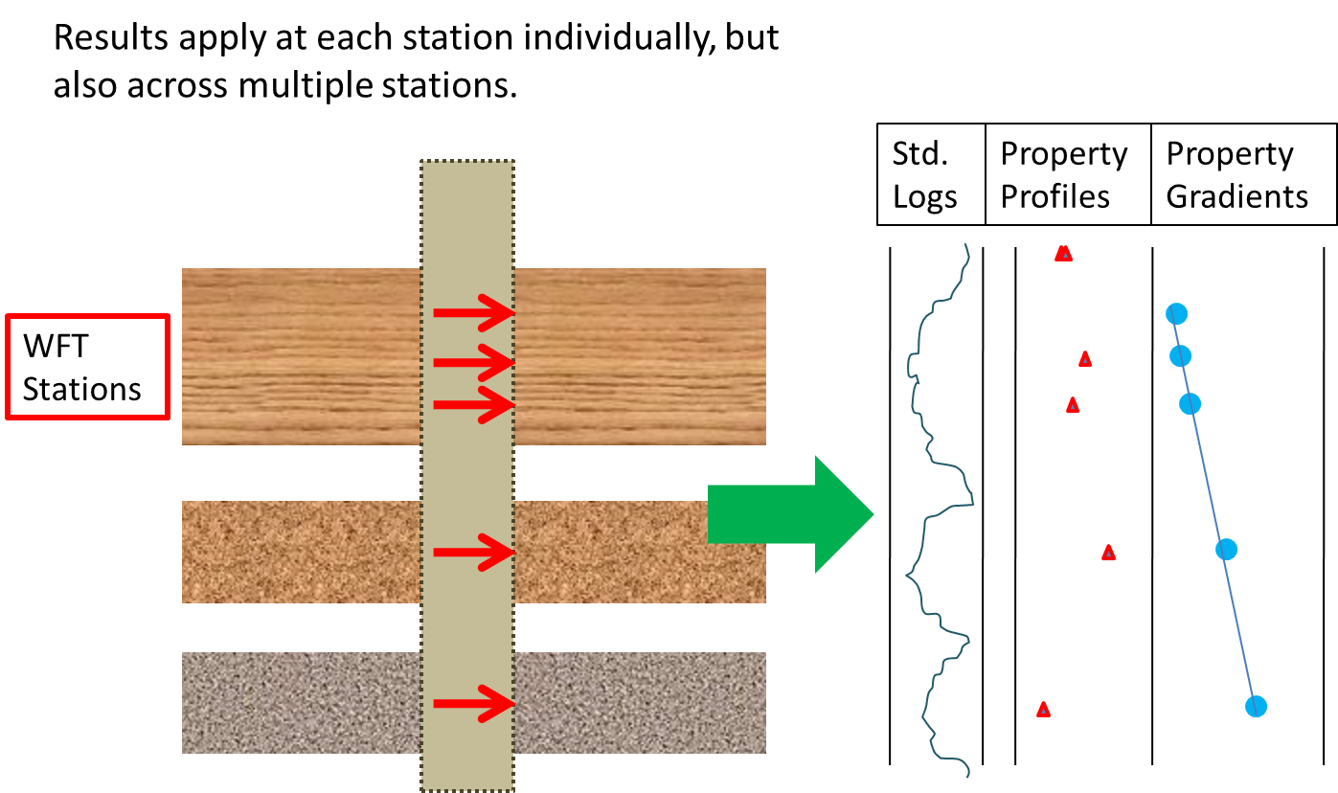
Results across stations

Slide 25
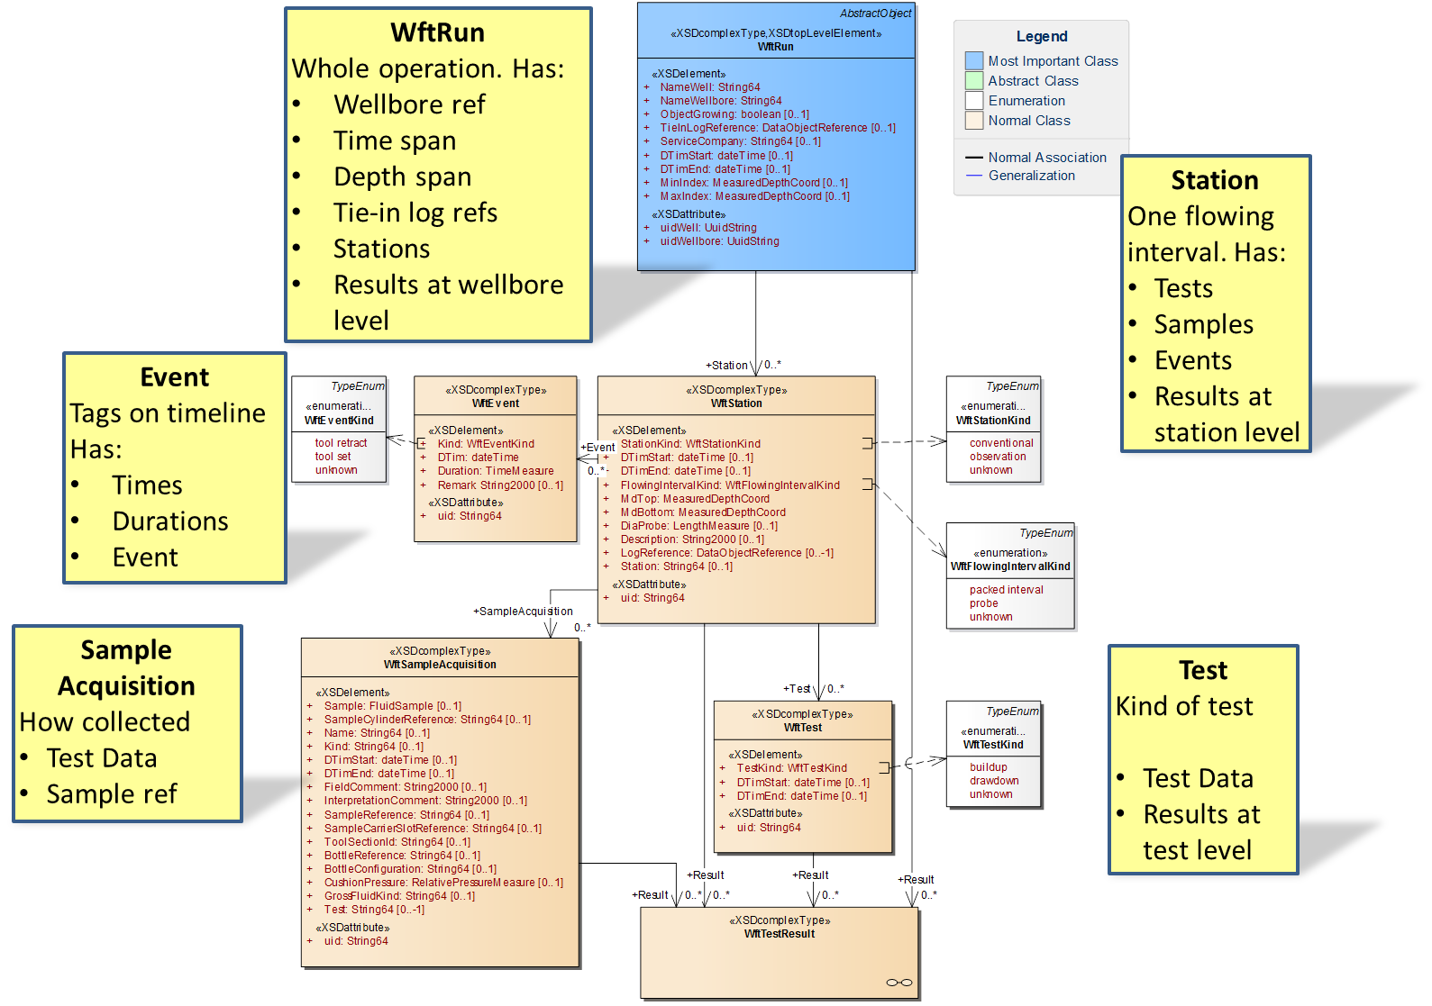
WftRun Top Level

Slide 26
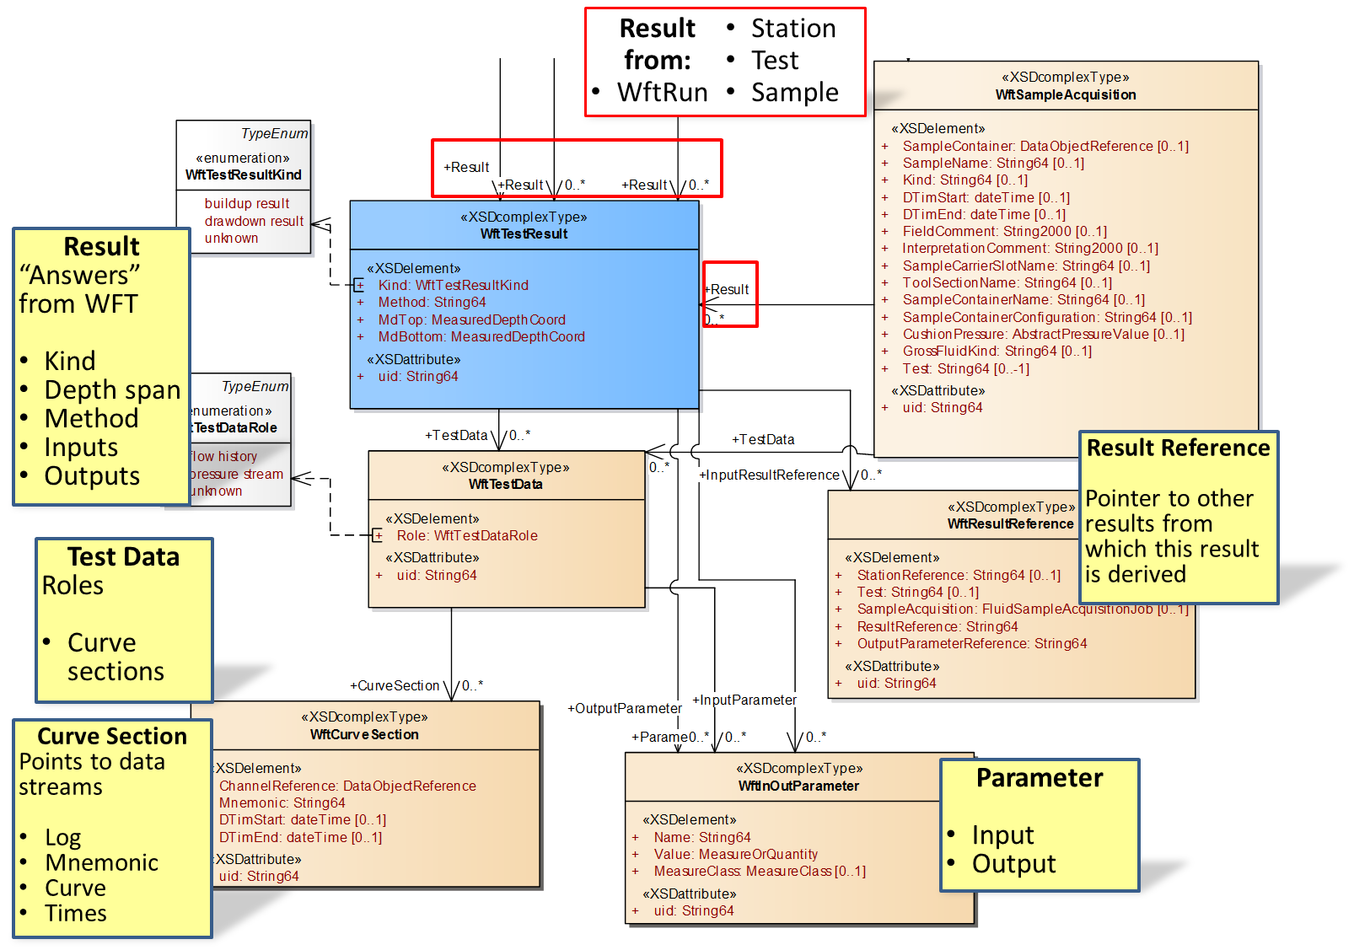
WftRun Results Section

